Slide 1
CHAPTER 2
  Working with Tables: Data Management and Retrieval‏

Slide 2
TODAY . . .
You will learn how to populate tables using Data Manipulation Language (DML) statements.
You will also learn to change existing data and to remove unwanted rows/records.
Data retrieval queries on single tables.
Various clauses are used with data retrieval queries for filtering and sorting of data.
CASE structure is introduced

Slide 3
DATA MANIPULATION LANGUAGE (DML)‏
A SQL language’s Data Manipulation Language (DML) consists of three statements:
      INSERT
      UPDATE
      DELETE
Data retrieval language, also known as a subset of DML, consists of SELECT statement and its clauses.
A new row is added to a table with the INSERT statement.
Data in existing row(s) is/are changed with the UPDATE statement.
The DELETE statement removes row(s) from a table.
The SELECT statement retrieves data from table(s), but it does not affect data in any way. In other words, SELECT statement does not manipulate data, it only queries tables.
The DML statements are not written permanently to database.

Slide 4
ADDING A NEW ROW/RECORD
Used to insert a new row/record into a table.
A user can insert values for all columns or a selected list of columns in a record.
The general syntax for the INSERT statement is as follows:
INSERT INTO tablename [(column1, column2, column3,...)]
VALUES (value1, value2, value3,...);
The column names are optional.
  If column names are omitted from the INSERT statement, you must enter a value for each column.
    If you know the order of column names in correct order, you can enter values in the same order following the VALUES keyword.
  If you do enter column names, they do not have to be in the same order as they were defined in table’s structure at the time of creation.
    Once you enter column names, their respective values must be in the same order as the column names.

Slide 5
ADDING A NEW ROW/RECORD
When entering values, numeric data is not enclosed within quotes.
The character and date type values are enclosed within single quotes.
There are two methods for inserting a NULL value in a column.
  Implicit Method. The column’s name is omitted from the column list in an INSERT statement.
INSERT INTO dept (DeptId, DeptName) VALUES (50, ‘Production’);
  Explicit Method. The value NULL is used as a value for numeric column, and an empty string (‘’) is used for date or character columns.
INSERT INTO dept (DeptId, DeptName, Location, EmployeeId) VALUES (60, ‘Personnel’, ‘Chicago’, NULL);

Slide 6
ADDING A NEW ROW/RECORD
The default format to enter the date value is ‘DD-MON-YY’.
  In Oracle9i, format DD-MON-YY as well as DD-MON-YYYY are default formats.
  If you want to enter a date in any other format, the TO_DATE function is used for converting a character value to the date equivalent.
TO_DATE (‘02/12/1980’, ‘MM/DD/YYYY’)‏
TO_DATE (‘FEB 12, 1980’, ‘MON DD, YYYY’)‏
  If you insert value 543.876 in a NUMBER(6, 2) column, precision is 4 and scale is 2. The resulting value will be 543.88, rounded to 2 decimal places or scale of 2. The rounded value will be entered into the column.

Slide 7
ADDING A NEW ROW/RECORD
While inserting values, you must remember that the foreign key columns in a table must either have a NULL value or that value must already exist as a primary key value in the table referenced by the foreign key.
You must populate tables without foreign keys first; in other words, the parent tables must be populated before their child tables.
NULL values are allowed in non-primary-key columns, that do not have a NOT NULL constraint.
  Check the ‘Null?’ display from the DESCRIBE command before inserting null value.

Slide 8
UPDATING EXISTING ROWS/RECORDS
Used to modify data.
Only one table can be updated at one time.
It is possible to change more than one column at a time.
The general syntax is
UPDATE tablename SET column1 = newvalue
[, column2 = newvalue,...] [WHERE condition(s)];
The condition is optional, but in most cases you would need to use it.
If the condition is not used with UPDATE, all rows will be updated.
UPDATE student SET majorid = 700 WHERE stuid='1';

Slide 9
WHERE Clause
Relational Operators
= equal to
<> or != not equal to
> greater than
>= greater than or equal to
< less than
<= less than or equal to
Logical Operators
AND Returns true only if both conditions are true
OR Returns true only if one or both conditions are true
NOT Returns true the condition is false
Other Comparison Operators
IS NULL Is a null value
BETWEEN ... AND Is between a range of values (both included)‏
IN Match any value from a list (alternate way to OR)‏
LIKE Match a value using wild cards

Slide 10
DELETING EXISTING ROWS/RECORDS
Used for deleting unwanted rows.
DELETE [FROM] tablename [WHERE condition(s)];
The WHERE clause adds a condition to the DELETE statement.
  You normally would delete only those records that meet a criterion.
  The DELETE statement without a condition will result in a table with no rows.
    Same effect as a TRUNCATE statement.
If you try to delete a record from a table whose primary key value is used in another table’s foreign key column, Oracle will display an ‘Integrity constraint … violated–child record found’ error message.
  The parent record that is referenced by a child record cannot be removed.
DELETE FROM dept WHERE deptid=70;

Slide 11
RETRIEVING DATA FROM A TABLE
A user retrieves data from the underlying table or tables with a SELECT query.
The output can be sorted, it can be grouped, and information can be derived with the use of mathematical expressions and built-in functions.
The general syntax is
SELECT columnlist FROM tablename;
If you want to see all columns in a table, you do not have to list them all.
  You can use character asterisk (*) in place of the column list, and all columns will be displayed in the same order as the underlying table structure.
SELECT * FROM tablename;
The default column width for displaying NUMBER column is 9.
The display width for character columns is based on column’s width.

Slide 12
RETRIEVING DATA FROM A TABLE
The DISTINCT function is used to suppress duplicate values.
  The word DISTINCT is used right after the keyword SELECT and before the column name.
SELECT [DISTINCT] columnname FROM tablename;
When a SELECT query is executed, SQL*Plus uses the column’s name as the column heading.
Column aliases are useful because they let you change the column’s heading.
SELECT columnname [AS] alias FROM tablename
Examples:
SELECT first, last FROM student;
SELECT * FROM student;
SELECT DISTINCT first FROM student;
SELECT first AS FirstName FROM student;

Slide 13
RETRIEVING DATA FROM A TABLE
The arithmetic expressions are used to display mathematically calculated data.
  These expressions use columns, numeric values, and arithmetic operators.
  When arithmetic operators are used with columns in the SELECT query, the underlying data is not changed.
  The calculations are for output purposes only.
Order of Operation:
  Whatever in parentheses is done first.
  Multiplication and division have higher precedence than addition and subtraction.
  If more than one operator of the same precedence is present, the operators are performed from left to right.
  SELECT Salary+Commision FROM employee

Slide 14
RETRIEVING DATA FROM A TABLE
A WHERE clause is used with the SELECT query to restrict rows picked.
It is the implementation of a selection operation.
The WHERE clause uses a simple condition or a compound condition.
The rows, which satisfy supplied conditions, are displayed in the output.
The general syntax of the WHERE clause is
SELECT columnlist FROM tablename [WHERE condition(s)];
SELECT * FROM dept WHERE Location='MONROE';
SELECT * FROM location
WHERE Capacity BETWEEN 40 AND 45;

Slide 15
WILD CARDS
There are times when you do not know the exact string value.
You can select rows that match a pattern of characters.
Such a search is known as a wild card search.
There are two wild cards for a pattern search.
  % Represents 0 or more characters.
  _ (Underscore) Represents any 1 character.
A search with the wild cards requires you to use the LIKE operator.
SELECT Name, Phone FROM faculty WHERE Name
LIKE 'C%';

Slide 16
RETRIEVING DATA FROM A TABLE
The order of rows in a table is arbitrary.
You can insert rows in any order, and you do not have control over where rows will be inserted.
When you type a SELECT query, the order of rows is not defined.
You may want to see rows in a specific order based on a column or columns.
The ORDER BY clause is used with the SELECT query to sort rows in a table.
  The rows can be sorted in ascending or descending order.
  The default order is ascending
SELECT First, Last FROM student ORDER BY Last;
SELECT Lname, Salary FROM employee WHERE deptid=30 ORDER BY Lname;

Slide 17
RETRIEVING DATA FROM A TABLE
CASE structure is allowed anywhere expressions are allowed in SQL statements.
CASE WHEN condition1 THEN Expression1
WHEN condition2 THEN Expression2
. . .
[ELSE Expression]
END
Example :
  SQL> UPDATE employee SET salary = CASE
        WHEN deptid=10 THEN salary*1.10
        WHEN deptid=20 THEN salary*1.05
        ELSE salary
        END

Slide 18
Practice Exercises
Use SQL statements to create all six tables from the Corporation database.
  Define the primary key, foreign key, NOT NULL, DEFAULT, CHECK, and UNIQUE constraints in the CREATE TABLE statement.
  If not possible, use ALTER TABLE statement to add a constraint.
Populate the database using the text file provided.
Write the following queries.
  Display all employee names (last name and first name separated by a comma and a space) and salary with appropriate column aliases.
  Display all employees who do not get any commission.
  Give a 10% raise to employee number 111.
  Delete department number 30 from the department table. If it is not successful, write down your suggestion to make it work.

Slide 19
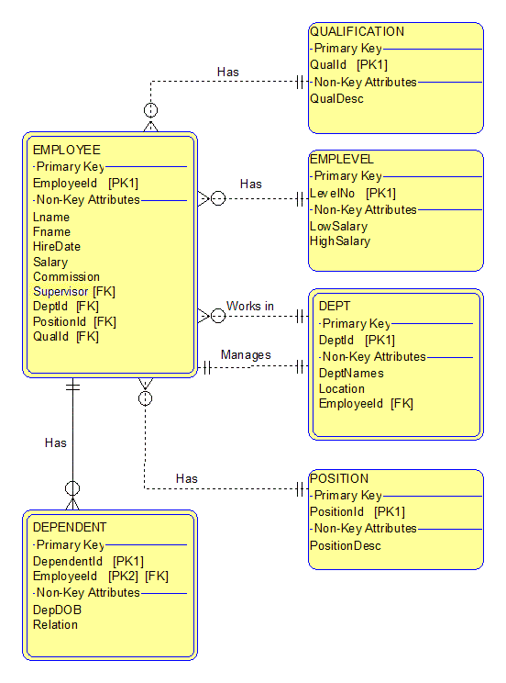

Slide 20
